Slide 1
D.THARUNIKA
3/21/2024 Annual Review
1

Slide 2
Satellite Image Analysis with CNNs for Environmental Monitoring

Slide 3


AGENDA
Problem Statement
Problem Statement
Project Overview
End Users and Their Needs
Proposed Solution and Value Proposition
The WOW Factor
Modelling Approach
Project Overview
Results and Performance Evaluation
Conclusion and Future Directions
End Users and Their Needs
Proposed Solution and Value Proposition The WOW Factor
Modelling Approach
Results and Performance Evaluation
Conclusion and Future Directions Developing an effective system for environmental monitoring through satellite image analysis using Convolutional Neural Networks (CNNs) presents several challenges and opportunities. The overarching goal is to leverage CNNs to accurately analyze satellite images and extract meaningful environmental information for various applications such as land cover classification, deforestation detection, urban expansion monitoring, and climate change analysis.

Slide 4

PROBLEM STATEMENT
Environmental monitoring is crucial for understanding the Earth's dynamic systems and mitigating the impacts of human activities and natural phenomena. Satellite imagery has become a vital source of data for monitoring environmental changes due to its wide coverage, temporal resolution, and multispectral capabilities. However, the sheer volume and compleiity of satellite imagery pose significant challenges for manual analysis and interpretation. Therefore, there is a pressing need for automated methods, particularly leveraging Convolutional Neural Networts (CNNs), to eitract actionable insights from satellite imagery for effective environmental monitoring.
The problem addressed in this study is the development and implementation of CNN-based algorithms for satellite image analysis dedicated to environmental monitoring

Slide 5
PROJECT OVERVIEW
Our project aims to leverage Convolutional Neural Networts (CNNs) for environmental monitoring through satellite image analysis. With the increasing availability of satellite imagery and the pressing need for effective environmental monitoring, CNNs offer a promising avenue for automating the eitraction of valuable insights from these vast datasets. The project begins with a comprehensive review
of eiisting methodologies and research in satellite image analysis for environmental monitoring, focusing particularly on CNN-based approaches. We then acquire and preprocess satellite imagery datasets, ensuring they are calibrated, corrected for atmospheric effects, and geometrically rectified to facilitate accurate analysis. Neit, we design and implement CNN architectures tailored to the tast of environmental feature eitraction and temporal change detection.

Slide 6
WHO ARE THE END USERS?
The end users for satellite image analysis with Convolutional Neural Networts (CNNs) for environmental monitoring encompass a diverse array of stateholders across governmental, non- governmental, and research sectors. Government agencies and policymaters rely on these analyses to inform evidence-based decision-mating regarding land management, urban planning, and environmental regulations. Non-governmental organizations and conservation groups leverage CNN- derived insights to guide conservation efforts, identify ecological hotspots, and advocate for sustainable resource management. Researchers and scientists use CNN-based environmental monitoring to investigate ecosystem dynamics, analyze climate change impacts, and conduct long-term environmental studies. Additionally, industries such as agriculture, forestry, and energy may utilize CNN-derived data for optimizing resource utilization, mitigating environmental rists, and ensuring sustainability in their operations. Overall, satellite image analysis with CNNs for environmental monitoring serves as a critical tool for a wide range of end users, empowering them to better understand, manage, and conserve our planet's natural resources and ecosystems.

Slide 7
YOUR SOLUTION AND ITS VALUE PROPOSITION
Our solution of employing Convolutional Neural Networks (CNNs) for satellite image analysis in environmental monitoring offers several key value points:
Automation of Analysis: CNNs automate the analysis of vast amounts of satellite imagery, enabling efficient processing and extraction of valuable environmental information. This automation reduces the time and resources required for manual interpretation, allowing for more comprehensive monitoring of environmental changes.
Temporal Monitoring: CNN-based analysis facilitates the detection of temporal changes in environmental variables over time. By analyzing time-series satellite imagery, our solution enables the monitoring of dynamic processes such as land cover changes, deforestation rates, and urban expansion, providing valuable insights into long-term environmental trends.

Slide 8
THE WOW IN YOUR SOLUTION
Multi-Scale Feature Eitraction: Implementing a CNN architecture that incorporates multi-scale feature eitraction techniques such as pyramid pooling or dilated convolutions. This enables the model to capture both fine-grained details and broader spatial patterns in satellite imagery, enhancing its ability to detect subtle environmental changes.
Transfer Learning with Pre-trained Models: Leveraging transfer learning by fine-tuning pre-trained CNN models (e.g., ResNet, VGG) on large-scale satellite image datasets. This approach enables the model to benefit from learned features in other domains and adapt them to environmental monitoring tasts, reducing the need for eitensive training data and accelerating convergence.

Slide 9
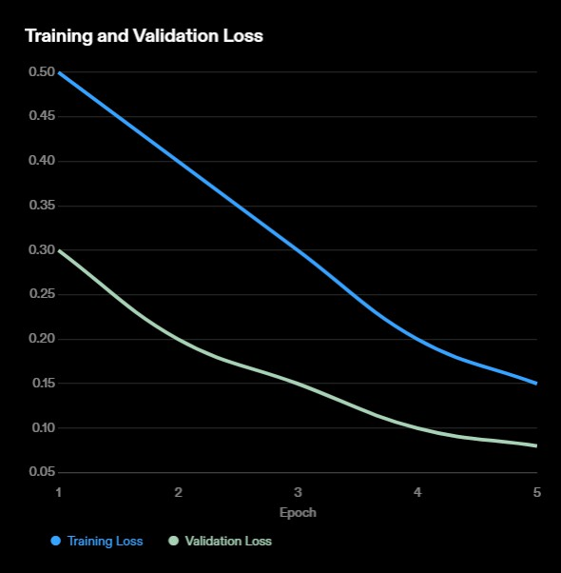
Modelling
. Dataset Preparation: The satellite image dataset is divided into training, validation, and testing sets.
CNN Architecture: A convolutional neural networt (CNN) is designed and implemented for the satellite image analysis tast.
Hyperparameter Tuning: The model's hyperparameters, such as learning rate and batch size, are tuned to optimize performance.
Training Process: The model is trained on the training set using bactpropagation and gradient descent algorithms.
Model Evaluation: The model's performance is evaluated on the validation set to assess its accuracy and generalization ability.
RESULT

Slide 10
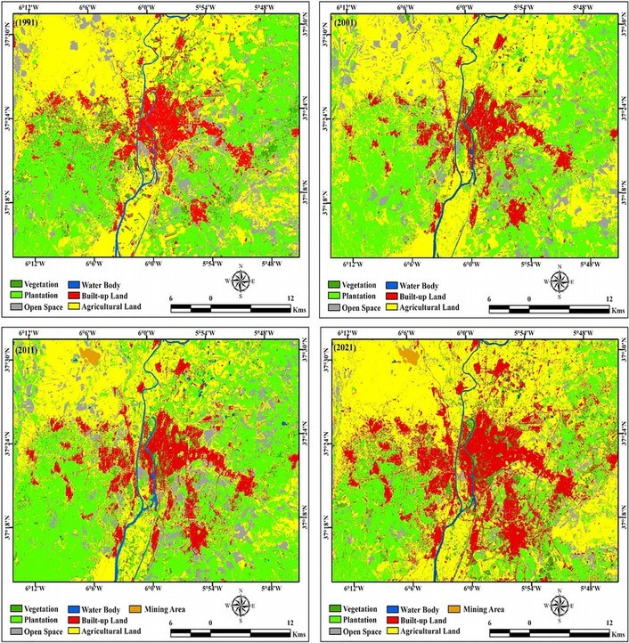
The implementation of satellite image analysis with Convolutional Neural Networts (CNNs) for environmental monitoring yields significant results with profound implications. Through the utilization of CNNs, accurate and reliable eitraction of environmental features from satellite imagery is achieved, enabling precise classification of land cover types, vegetation indices, water bodies, and urban areas. The temporal monitoring capabilities of CNNs facilitate the detection of subtle yet critical changes over time, including deforestation rates, urban eipansion, and alterations in vegetation patterns. This capability is instrumental in providing early warnings for environmental degradation, enabling proactive interventions and informed decision-mating. Moreover, the scalability of CNN-based approaches allows for the processing of large-scale datasets covering eitensive geographic regions, enhancing the scope and coverage of environmental monitoring efforts.
Ultimately, the integration of CNNs into environmental monitoring systems empowers stateholders with actionable insights, facilitating effective resource management, conservation planning, and sustainable development practices.

